Slide 1
Sales Analysis and Forecasting for an Online Retail Business
11- 12 – 2024
Srija Gunaganti
sg64349n@pace.edu
Practical Data Science
Masters in Data Science
Seidenberg School of Science and Technology, Pace University

Slide 2
AGENDA
Executive Summary
Project Plan Recap
Dataset
Data Cleaning
EDA
Modelling Methods
Finding
Reccomendations
2

Slide 3
Executive Summary
Problem: It is important for a store to maintain the stock properly. Stockouts of popular products leading to missed sales, causes Low retention of high-value customers, Seasonal sales fluctuations causing revenue inconsistency. Inefficient inventory planning leading to excess/shortage issues.
Solution:
Conduct a comprehensive analysis of online retail sales data.
Identify key sales trends, popular products, and high-value customers
Develop a predictive model for forecasting monthly sales.
3

Slide 4
Project Plan Recap
DELIVERABLES | DETAILS | DUE DATE | STATUS
Data & EDA | Identifying trends and patterns | 11-05-24 | Completed
Methods, Findings, Recommendations | Finding out methods | 11-12-24 | Completed
Final Presentation | Final completion deck | 12-03-24 | Pending
4

Slide 5
Dataset Overview:
Source: Online retail dataset (December 2010 – July 2011) from Kaggle
has over 541910 rows.
Key Attributes:
InvoiceNo: Transaction ID
StockCode: Product identifier
Description: Product Description
Quantity: Quantity purchased
InvoiceDate: Date of the Transaction
UnitPrice: Price per item
CustomerID: Unique customer
identifierCountry: Country of the customer
5

Slide 6
Data Cleaning and Preparation
Data Preparation Steps:
Removed rows with missing values in CustomerID to ensure accuracy in customer analysis.
Filtered out negative or zero values in Quantity and UnitPrice to prevent distortion in analysis.
Created a new column, TotalPrice = (Quantity * UnitPrice), to calculate the total revenue per transaction. Converted InvoiceDate to datetime format and set it as the index for time-series analysis.
6

Slide 7
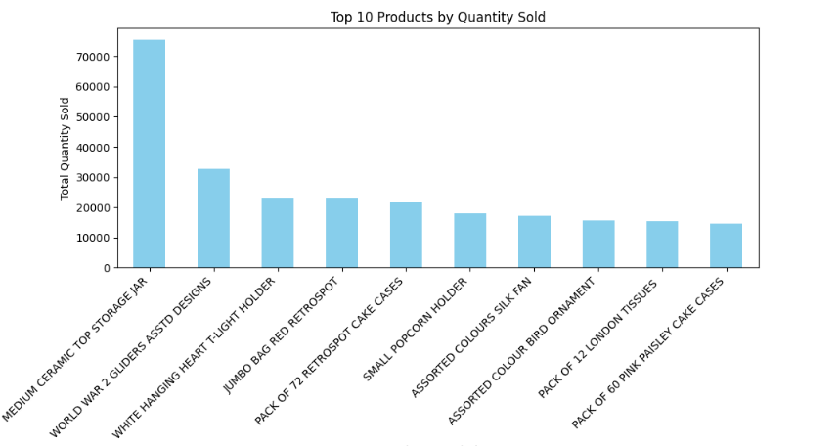
Top 10 Products by Quantity Sold
Objective: Identify the most popular products based on quantity sold
Analysis Method:
Aggregated sales quantities by product description.
Extracted the top 10 products with the highest total quantity sold.
Observation: The top product in terms of quantity sold was the ”MEDIUM CERAMIC TOP STORAGE JAR", indicating strong customer demand. Other frequently purchased items include decorative and household goods, highlighting customer preference for affordable, popular items.
Additional Observation: Most top-selling products are low-cost items, suggesting that customers tend to purchase these items in bulk.
7

Slide 8
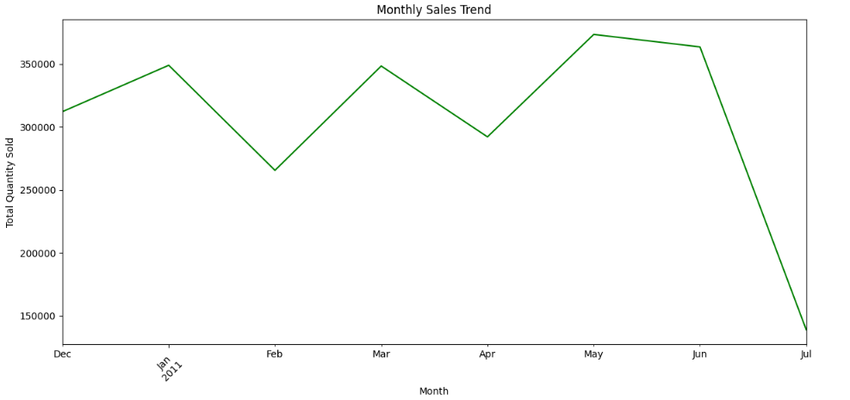
Monthly Sales Trend Observation
Sales peaked in December 2010, likely due to holiday shopping, and declined sharply in January, indicating typical post-holiday sales fluctuation. Sales then stabilized, with slight increases in spring.
Additional Observation: June and July show lower sales compared to December, suggesting a seasonal trend with a winter holiday peak and summer dip, which could guide future inventory and promotional planning.
8

Slide 9
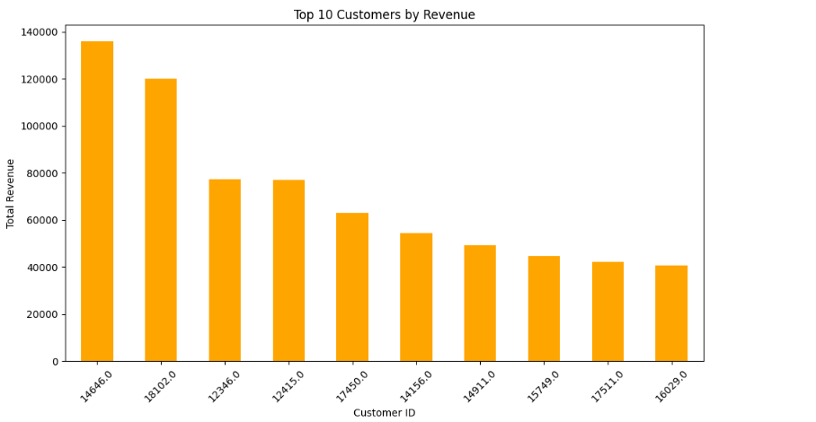
Top 10 Customers by Revenue Observation:
The highest revenue was generated by a small number of customers, with the top customer contributing significantly to total revenue. This shows a high dependence on a few loyal, high-spending customers.
Additional Observation: These top customers tend to make large purchases, indicating they may be business clients or regular customers with bulk purchasing needs, which could inform loyalty and retention strategies.
9

Slide 10
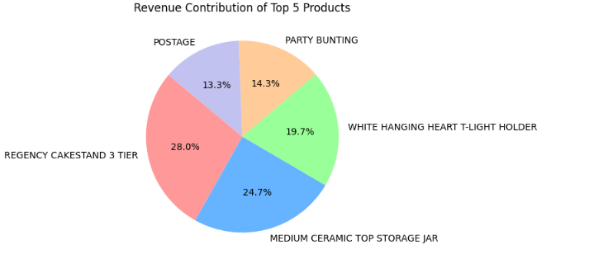
Revenue Contribution of Top 5 Products
The top 5 products account for a substantial share of total revenue, with the ”CAKESTAND" alone contributing a significant portion. This product dependency highlights the need to maintain stock levels for these popular items.
Additional Observation: Given this concentration in revenue, promoting these items or creating bundles could further enhance sales, while exploring additional products with similar appeal may diversify revenue sources.
10

Slide 11
MODELLING METHODS
OUTCOME VARIABLE:
The outcome variable is Sales Revenue. It is the total value of the sales made in a given period (week, month, etc).
Predicting sales revenue helps businesses estimate income, plan promotions, and manage financials.
11

Slide 12
Model Selection, Tuning and Training
Selected the ARIMA model based on its suitability for time-series data with seasonal patterns.
Used ACF (Autocorrelation Function) and PACF (Partial Autocorrelation Function) plots to determine initial parameters (p, d, q).
Optimized model parameters by minimizing AIC (Akaike Information Criterion) and BIC (Bayesian Information Criterion).
Trained the ARIMA model using historical sales data from December 2010 to June 2011.
Incorporated seasonal components to capture recurring patterns, such as holiday sales peaks.
12

Slide 13
FINDINGS
ARIMA model used to forecast monthly sales.
Performance metrics:
MAE (Mean Absolute Error): 142,346.83
It measures the average of absolute difference between predicted values and actual values.
RMSE (Root Mean Squared Error): 164,490.57
It gives large errors more than MAE, it is useful to avoid large errors in the predictions
Insights:
Provides guidance for inventory planning and promotional strategies.
13

Slide 14
Non – TechnicaL
Sales Peaks and promotional events:
This analysis reveals periods with higher sales which includes holiday seasons.
Customer Behaviour Patterns:
The model highlights regularities in customer purchasing behavior, such as increased sales on weekends or specific times of the year.
14

Slide 15
Recommendations
Stock High-Demand Products:
Maintain inventory for top-sellers to reduce stockouts.
Implement Loyalty Programs:
Reward high-value customers to boost retention.
Seasonal Promotions:
Target winter peaks and summer dips with tailored campaigns.
Forecast-Driven Inventory:
Use forecasts to align stock with expected demand.
15

Slide 16
THANK YOU

